Slide 1
Slug Hero
Team: Slug Heroes
Jinyan Li (Product Owner)
Vincent Moudy(Scrum Master)
Drake Pitts (Scrum Master)
Hairong Wu
Rihui Tan
Philip Toy

Slide 2

Slug Hero
What is Slug Hero?
Slug Hero is a website that provides a place for students to upload their course notes, ask questions, rate their professors, and share survival tips for classes they have taken.

Slide 3
Slug Hero --- Sprint Plan I
As an administrator, I need to be able to update course information in the database
As a student, I need to have an account and be able to login so that I can use the service
As a student, I want to add classes so that I can add course information for the classes
As a student, I want to look at courses review so that I can have better preparation
As a student, I want to ask questions related to a class or a department in a forum so that I can get help from others

Slide 4
Slug Hero --- Sprint Plan II
As a student, I want to access course notes from other students so that I can better understand the courses.
As a student, I want to upload course notes so that others can benefit from it.
As a student, I want to answer other students' question so that the issue can be solved.
As a student, I want to look at the professor review so that I can decide whether I want to take classes with the professor.

Slide 5
Slug Hero --- Sprint Plan III
As a student, I want to look at grade distribution of the class by different quarter and professor so that I can know the difficulty of the class.
As a student, I want to have a profile that shows all of my site activity.
As a student, I want to post textbook information so that other students can obtain the textbook in advance.

Slide 6
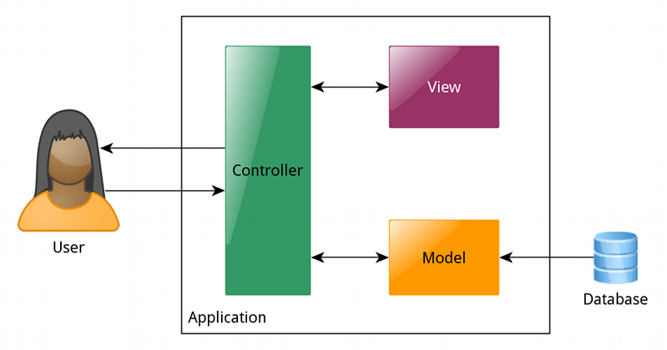
Project Architecture

Slide 7
Technologies
1: Web2py, Python - for implementing web application
2: HTML, CSS, Bootstrap - for structuring web pages
3: Highcharts - for creating grade distribution

Slide 8
Challenges
1: Implementing accounts and login securely.
2: Database for accounts, classes, and forum.
3: Searching classes, professors, forum posts.
4: Unfamiliar technology.

